Slide 1

Sprocket Central Pvt Ltd
Data analytics approach
Data Analytics Division - [Engagement Manager], [Senior Consultant], Nikita Suryawanshi

Slide 2
Agenda
Introduction
Data Exploration
Model Development
Interpretation

Slide 3
Introduction
Existing customer analysis to predict trends and generate business with new customer list
Several plots have been visualised to find relationship between the features to get a better understanding of the current database of customers. The feature selection is as follows:
Age, gender distribution
Job industry
Wealth segment
Cars owned, bike purchased
State
Profit and the transaction month

Slide 4
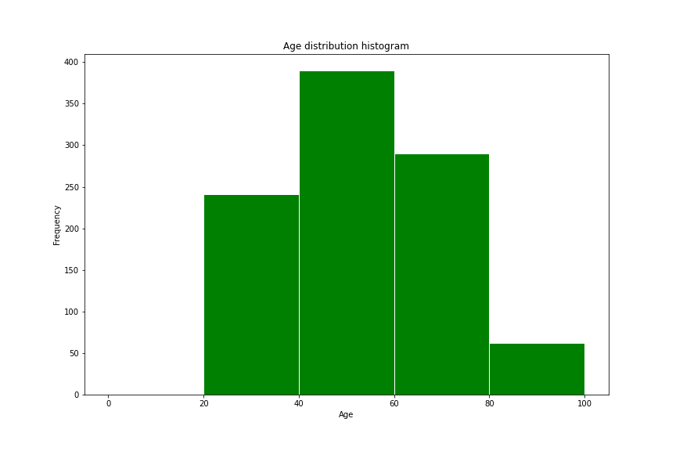
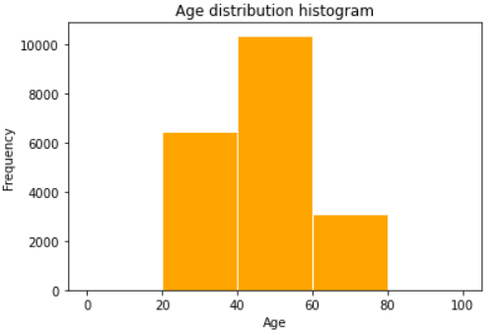
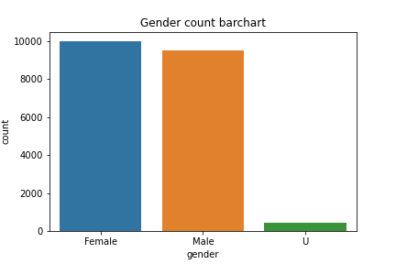
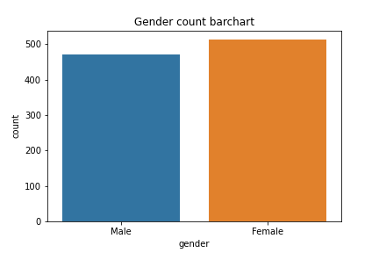
Data Exploration
Age and Gender Distributions in current and target database
We can see that the age and gender distribution is very similar in the current customers and the target customers.
The age group between 40-60 is more predominant in both the databases
The count of male and female in both the databases are very similar.

Slide 5
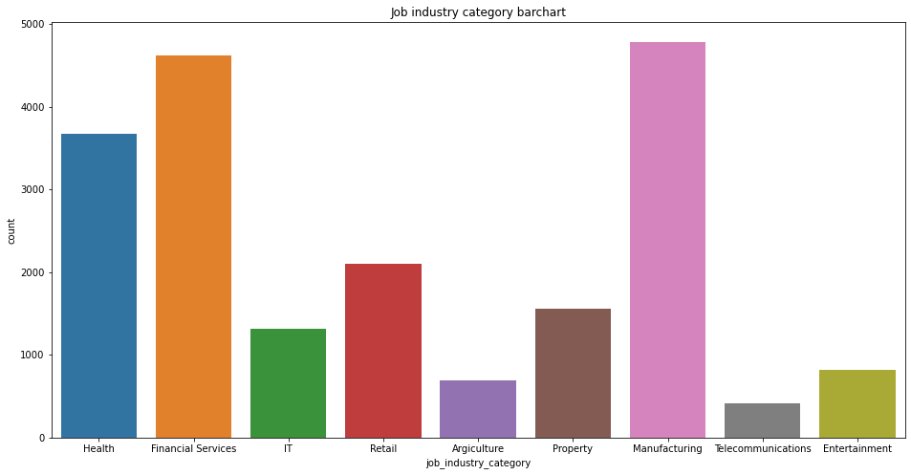
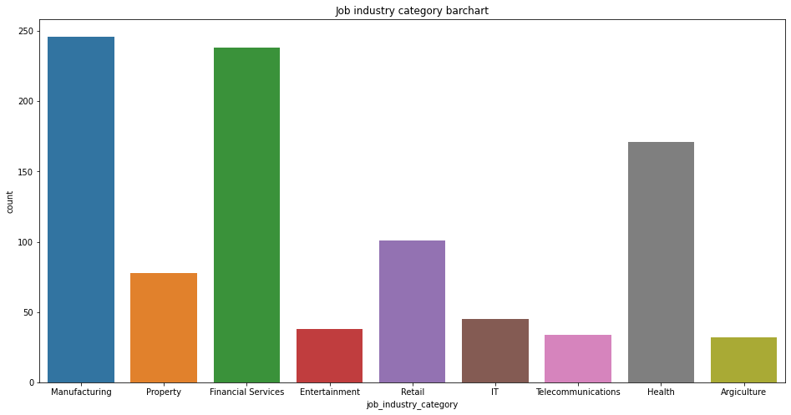
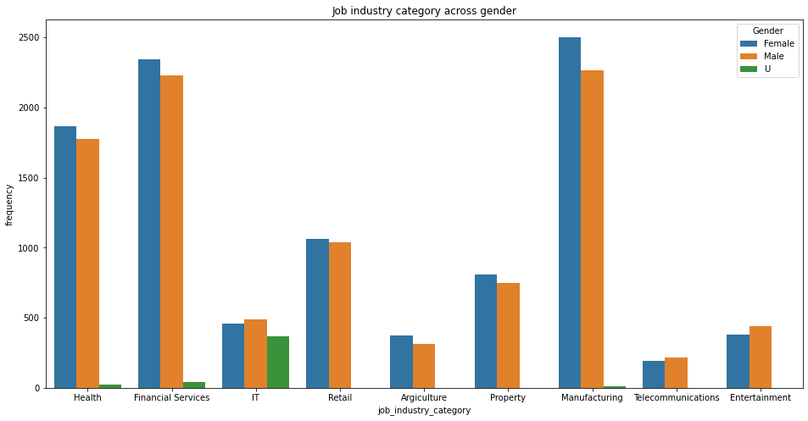
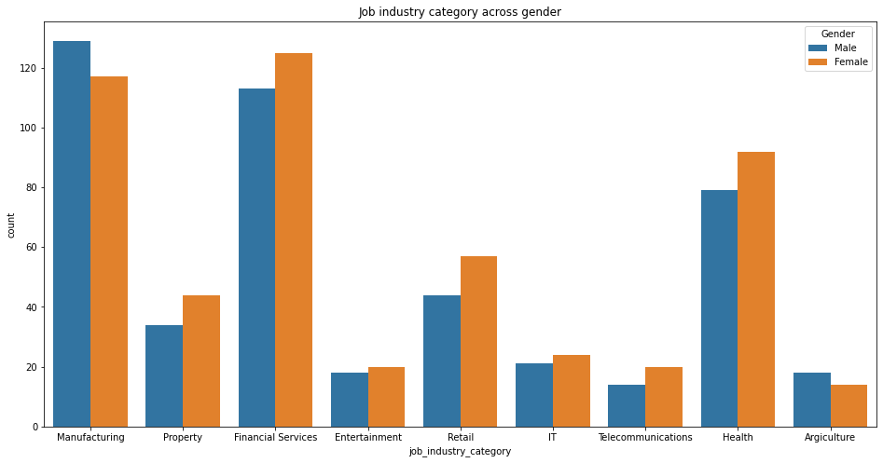
Data Exploration
Job category and its relationship with gender
We notice that the top 3 job categories in the current database are Manufacturing, Financial services and Health which reflects in the target database as well.
There is a very minute difference in the count of male and female which suggests that the gender can be ignored with respect to the job category of the customers.

Slide 6
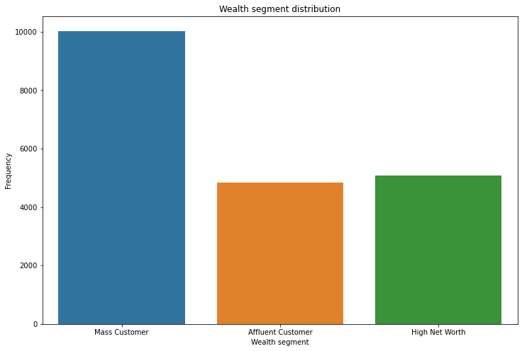
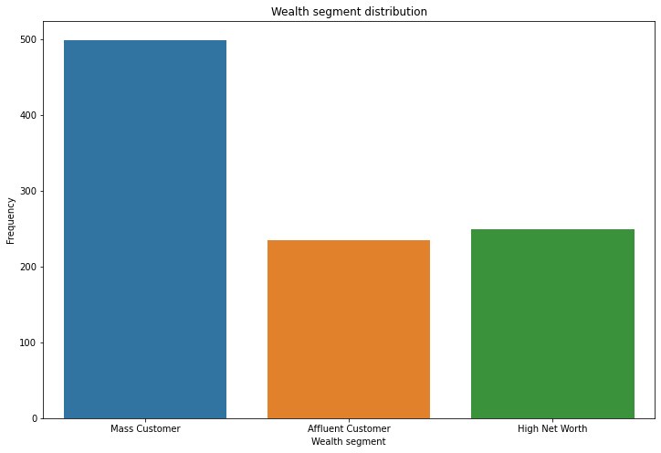
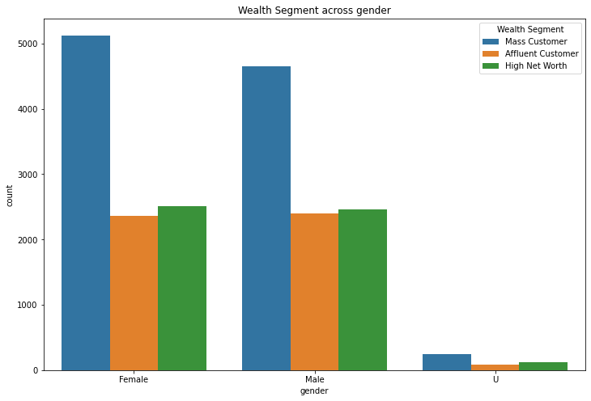
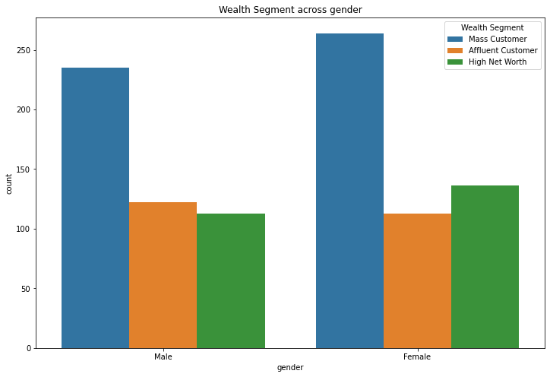
Data Exploration
Wealth segment and its relationship with gender
The mass affluent customer base has the highest number of purchases in the current database compared to the affluent and HNI.
The female customers in the mass affluent has the highest number of purchases in the customer base.
We see the same trend of customer distribution seen in the target database as well.

Slide 7
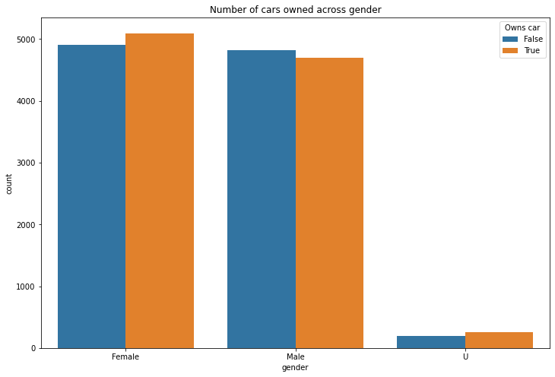
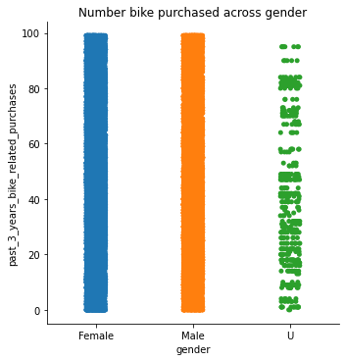
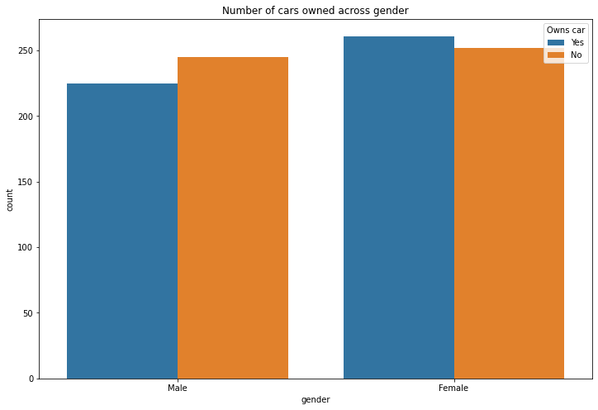
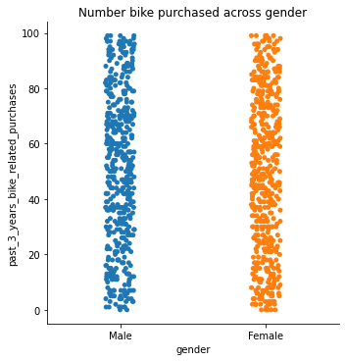
Model Development
Car owned and bike purchased across gender
Almost 50% of the customers across both genders own cars with the female leading in number slightly.
The consensus for the target customers show similar results
The bike purchases are also a significant number in both the genders.
The target customer list has a similar ratio of cars owned across gender and few bike purchases.

Slide 8
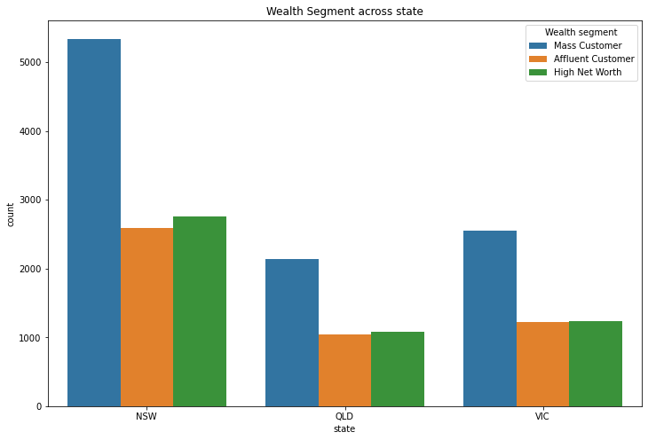
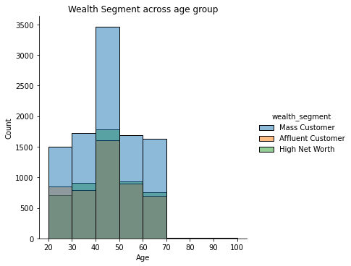
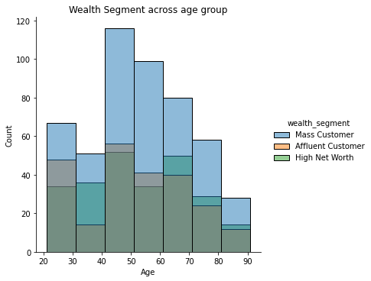
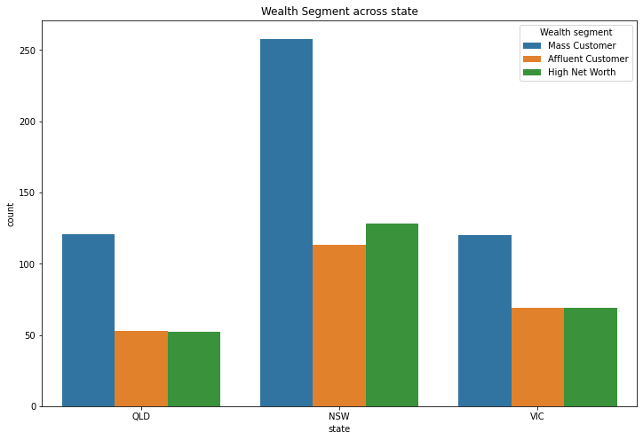
Interpretation
Wealth segment interpretation
The mass affluent customers between ages 40-50 show the most purchases in the current customer database.
New South Wales has the highest number of purchases
We can target the mass customers and increase their number in the database for better profits.
Most of the target customer lie between the ages of 40-70.We can market bike purchases for the ages 20-40 for better profits.
As NSW already has decent profits compared to the other two states, we can target marketing in QLD and VIC to further the profits.

Slide 9
Thank you

